Slide 1
CRIME.
PROBLEM
Notes:
CRIME.
Costly, Really Injust, Malicious, Endangering
It's a net negative for society
And we should care, because we physically exist in a place with it – Boston
That's right. There is crime in Boston–– from theft, to violence, to arson.
One way to get ahead of that, w/o propping surveillance everywhere like the Chinese, is to better anticipate the crime. What crimes tend to happen where and when?
And that's where some data can help us

Slide 2
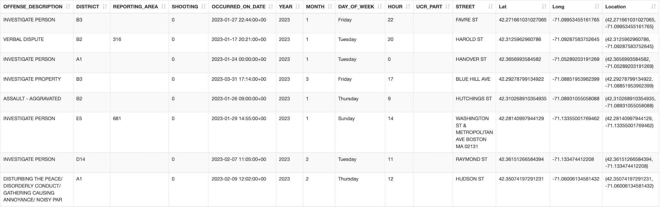
Introduction to Data
Dataset: Crime Incident Reports 2023
- contains unique crimes, location, time of police response
- 146,150 rows
Author: Boston Police Department
- from data.boston.gov –– aka "Analyze Boston"
Collection Method: Officers collect data
- document "initial details" whenever they respond to an incident
Notes:
Fortunately, the Boston Police Department collects data of the initial details whenever they respond to crime–– 150,000 cases: the type of crime, location, time
That all gets compiled + posted onto the city government's public data website
We analyzed the 2023 dataset to see how it could help us minimize crime. But before we delve into that–– concerns

Slide 3
Concerns
PRIVACY:
Individuals may still be
identifiable
ETHICS:
Higher Crime in Certain Communities
=> Interpret w/ Caution
BIASES:
Only contains crime that was caught
Excludes data
(per MGL ch.41 s.98f)
=> not fully representative
Notes:
First, Privacy
Though the dataset doesn't have any personal info, because it contains crime type, time, and exact location, individuals' identities may still be deducible
Ethically,
Crime may be more prevalent in certain communities amongst certain groups, so we need to take care that what we interpret doesn't perpetuate stereotypes
As for biases,
1) the dataset only contains crime that was caught, which means there's likely still crime, where people weren't caught, that are out of our scope
2) then, the dataset's caption discloses that certain data was excluded, per Massachusetts Law, which does undermine its transparency
Now, our analysis.

Slide 4
Approaches
Describe the data science algorithms or techniques you applied in the analysis of your data (e.g., linear regression, monte carlo simulations, etc.). Do not describe your code.

Slide 5
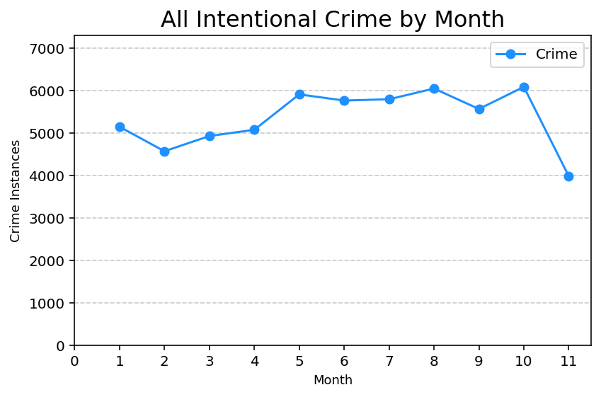
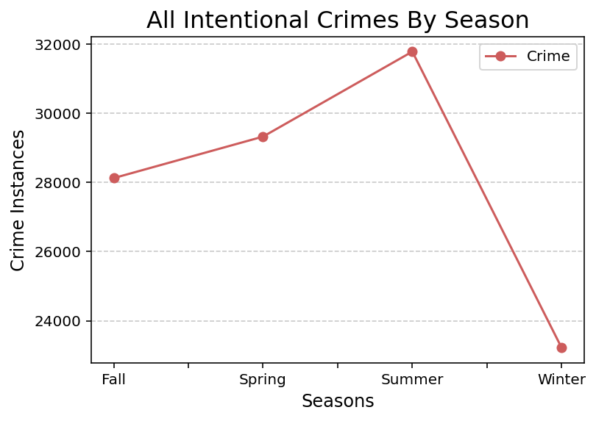
How does Crime Trend through the Year?
Filtered to INTENTIONAL crimes–– most targettable
-Think: Having info helps police
Highest in the Summer + Lowest in the Winter
Notes:
To discuss our findings, we're going to start broad to specific.
Our first direction of questioning was: How Does Crime Trend through the Year? Does seasonality tell us anything?
First, we filtered the data to intentional crimes.

Slide 6
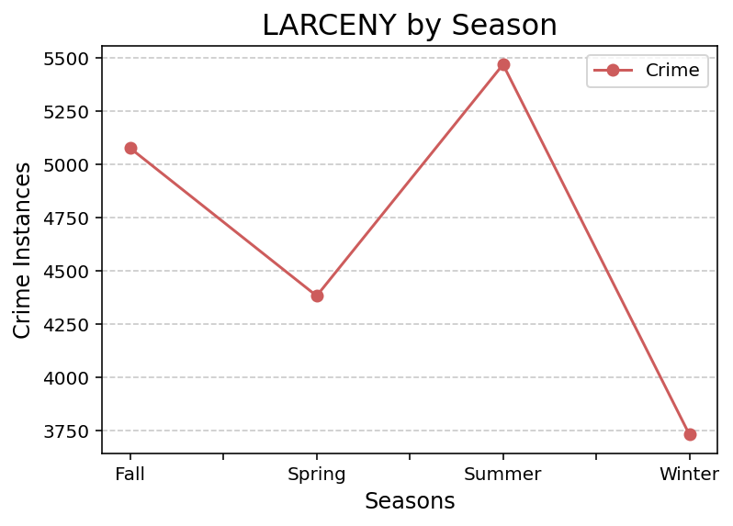
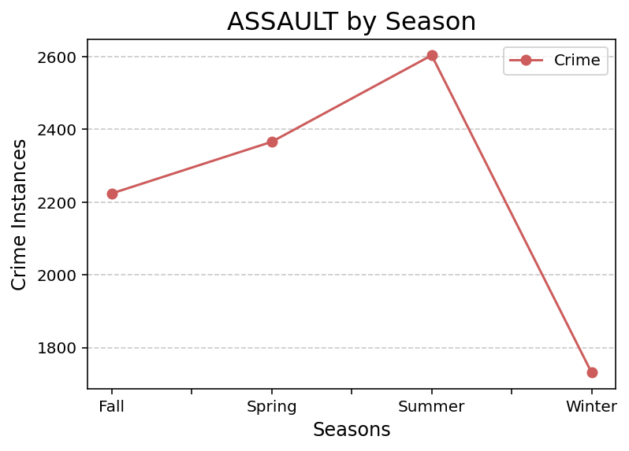
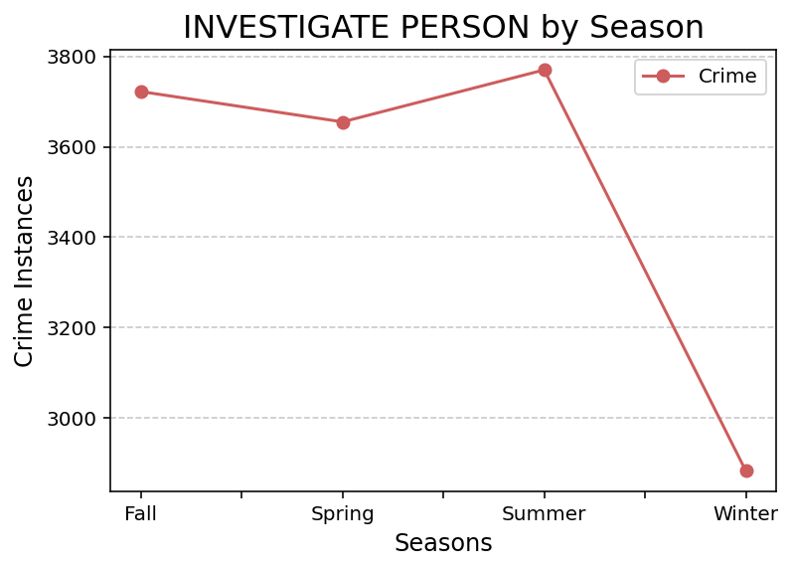
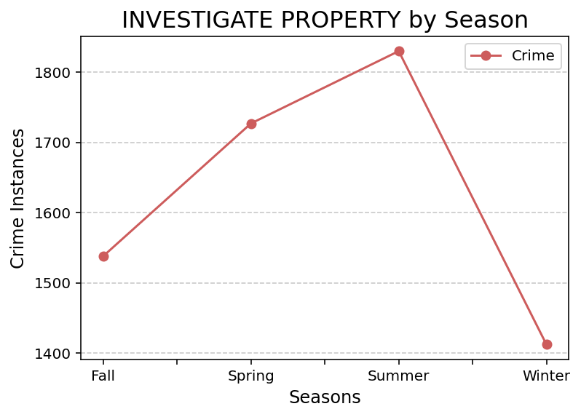
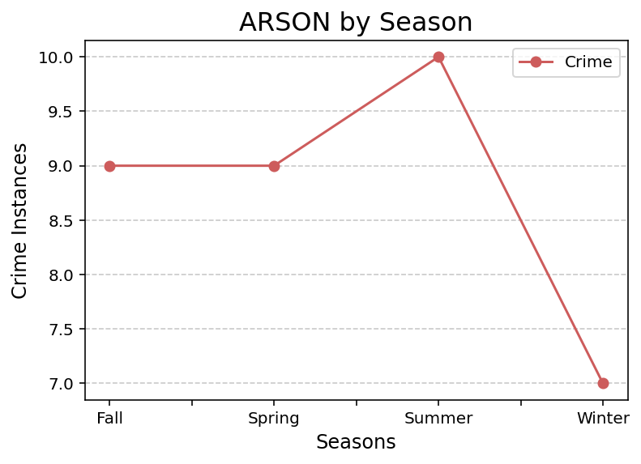
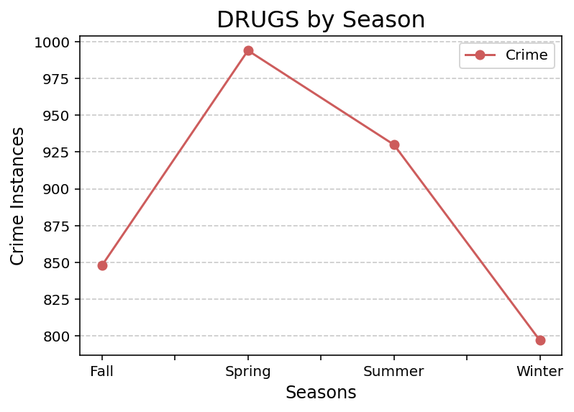
Specific Crimes? selected for either being most frequent or most severe
Notes:
Some rise in the Fall but dip in the Spring; some rise in the Fall, keep rising through Spring
But we see in all of them, crime is highest in the Summer, and drops substantially in the Winter; NOT to zero, the bottom still varies between all the different crimes.
But relative to the rest of the year, it's still a great drop nonetheless

Slide 7
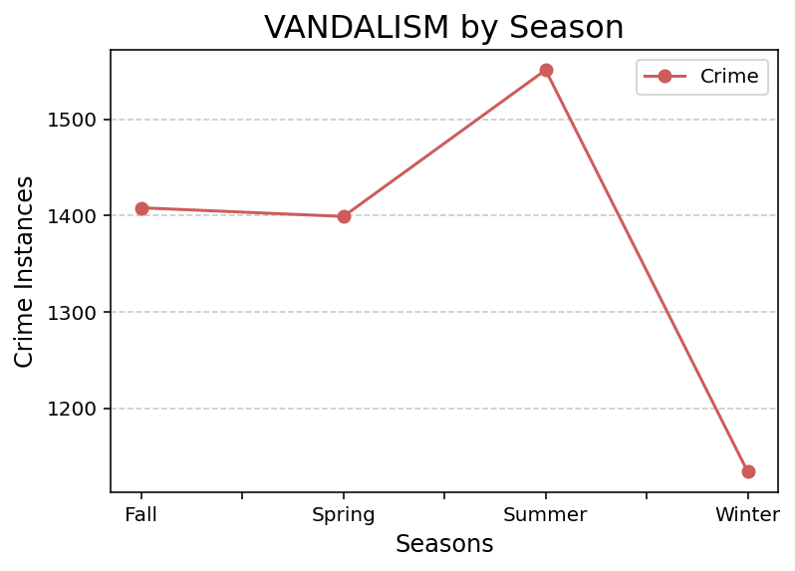
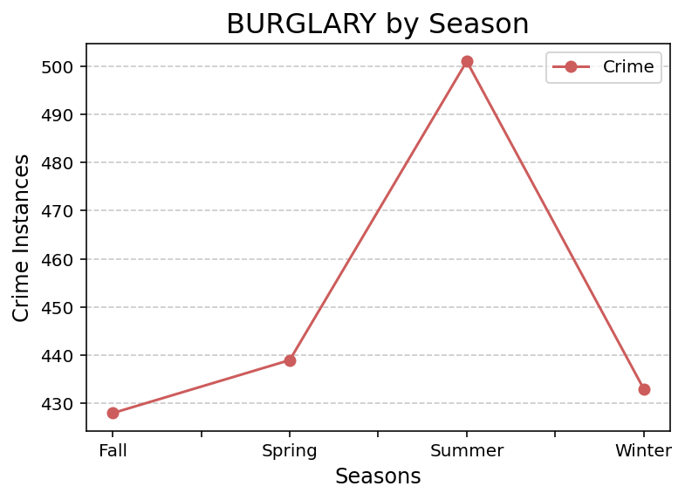
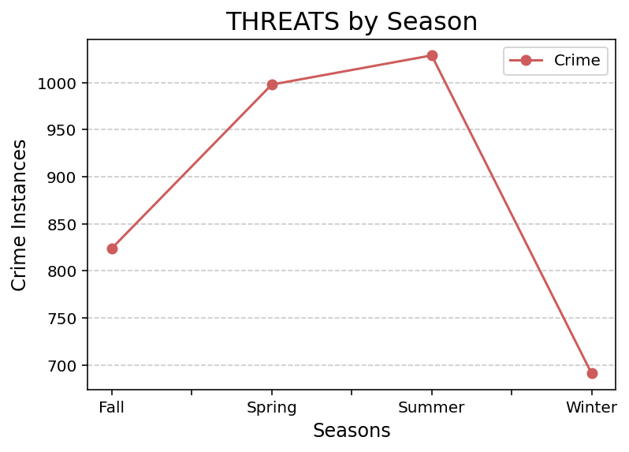
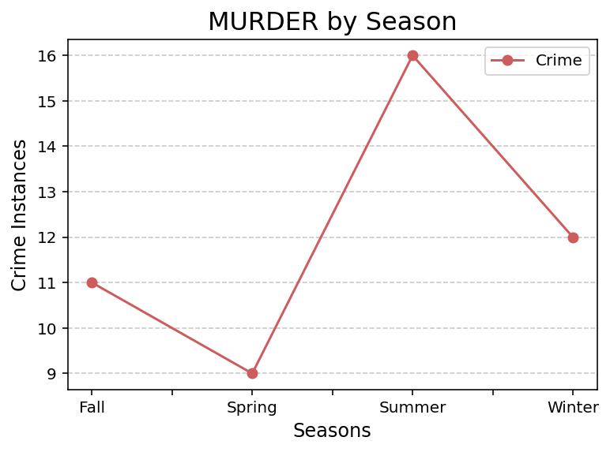
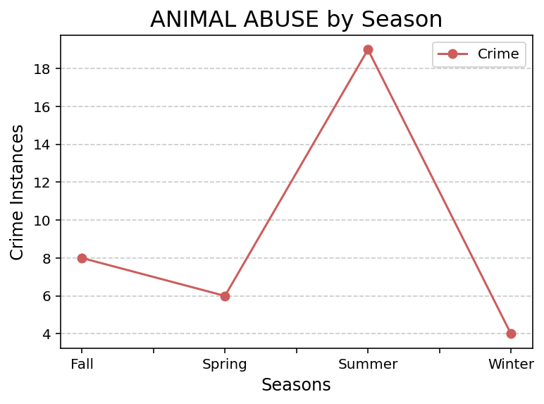
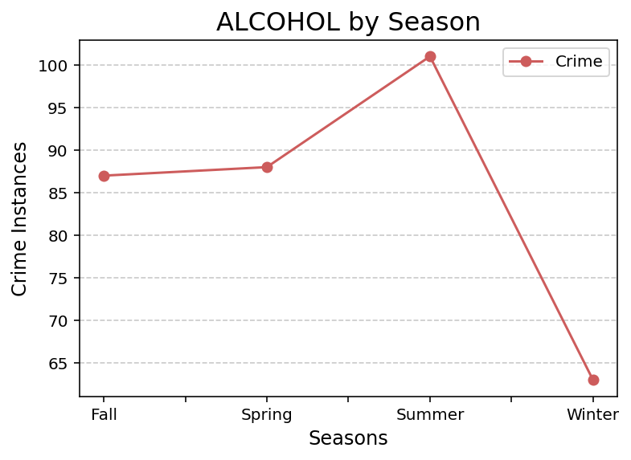

Slide 8
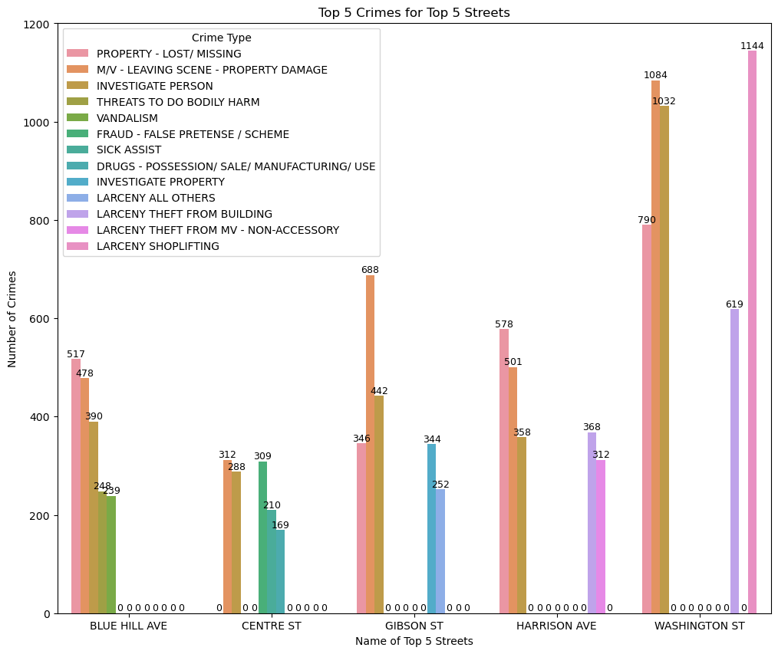
How does Crime Vary Geographically?
Top 5 Streets w/ most Crime:
1) WASHINGTON ST
2) BLUE HILL AVE
3) HARRISON AVE
4) GIBSON ST
5) CENTRE ST

Slide 9
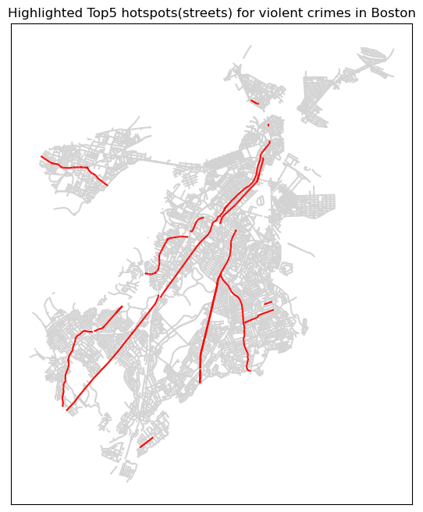

Slide 10
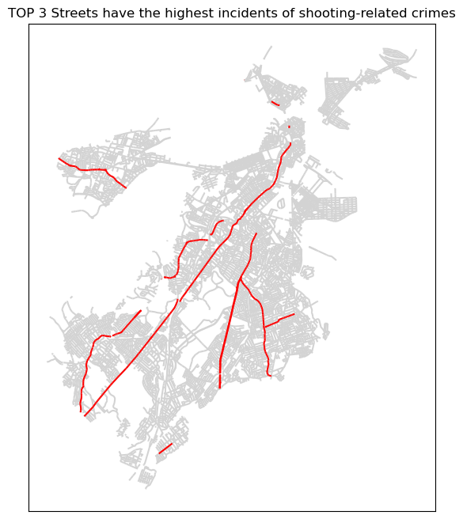
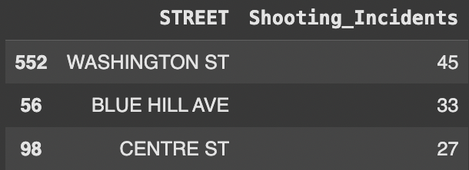

Slide 11
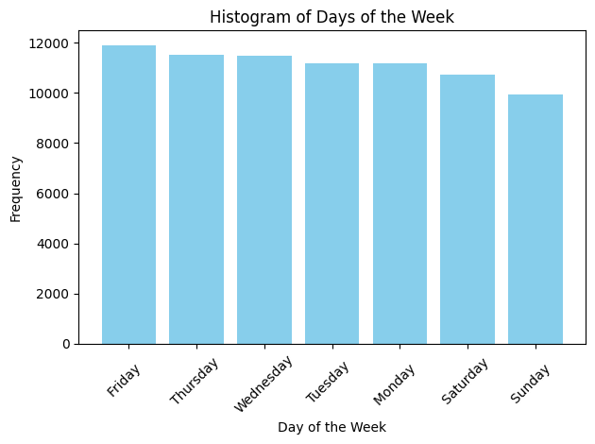
Crime through the Day?

Slide 12
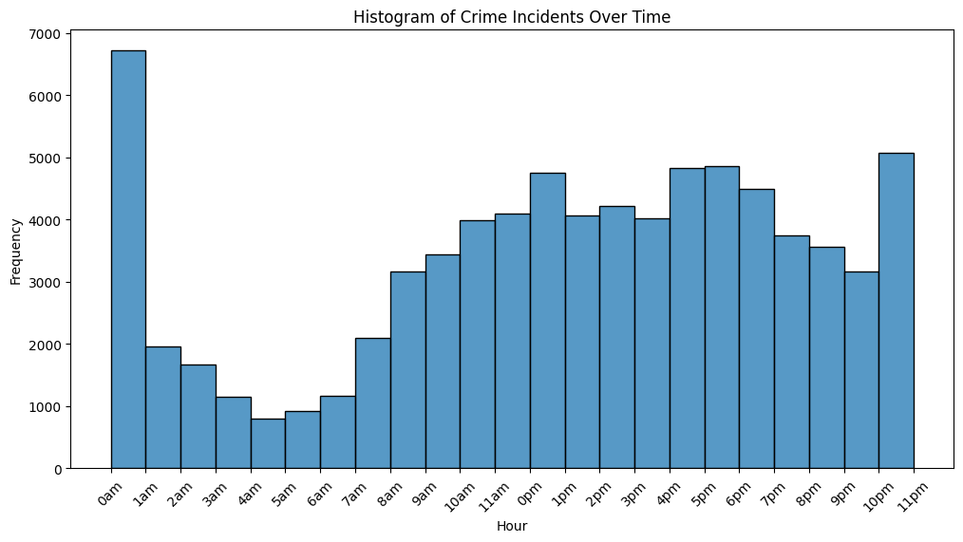

Slide 13
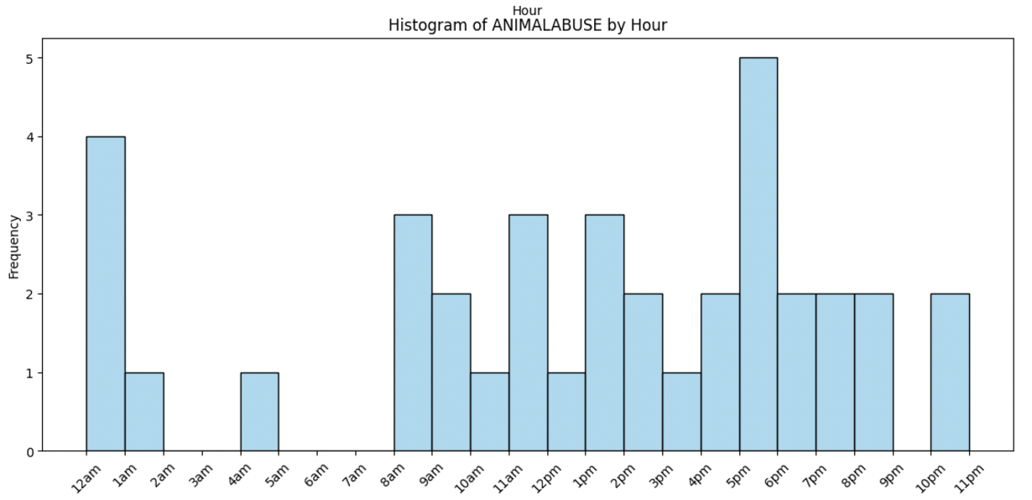
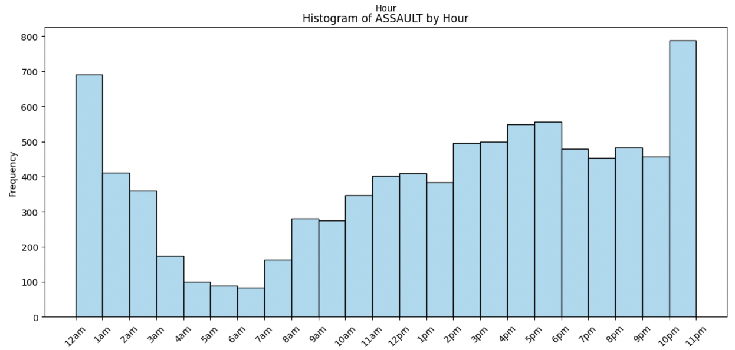
ANIMAL ABUSE
Low: 2am-4am + 9pm-10pm
High: 5pm-6pm
ASSAULT
Low: 4am-6am
High: 11pm-1am

Slide 14
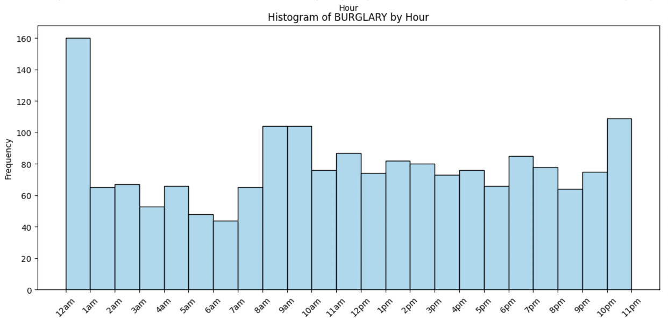
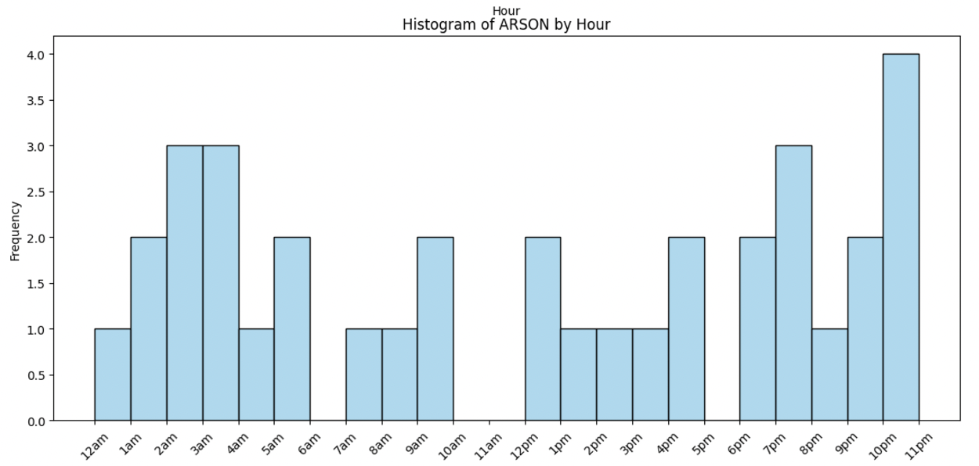
BURGLARY
Low: 5am-7am
High: 12am-1am
ARSON
Low: 10am-12pm
High: 10pm-11pm

Slide 15
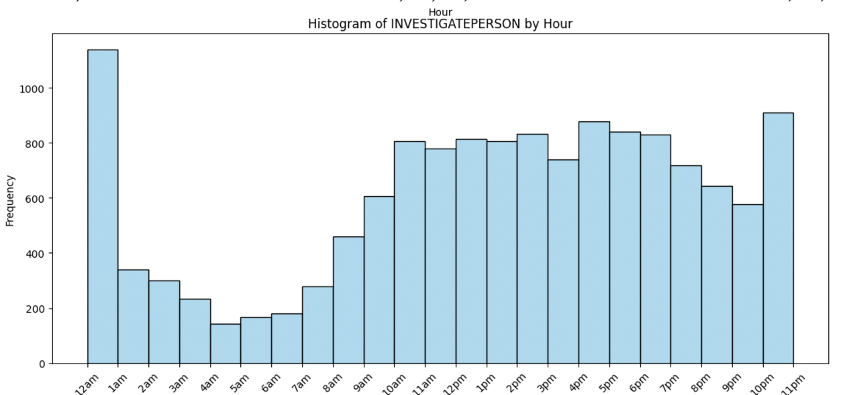
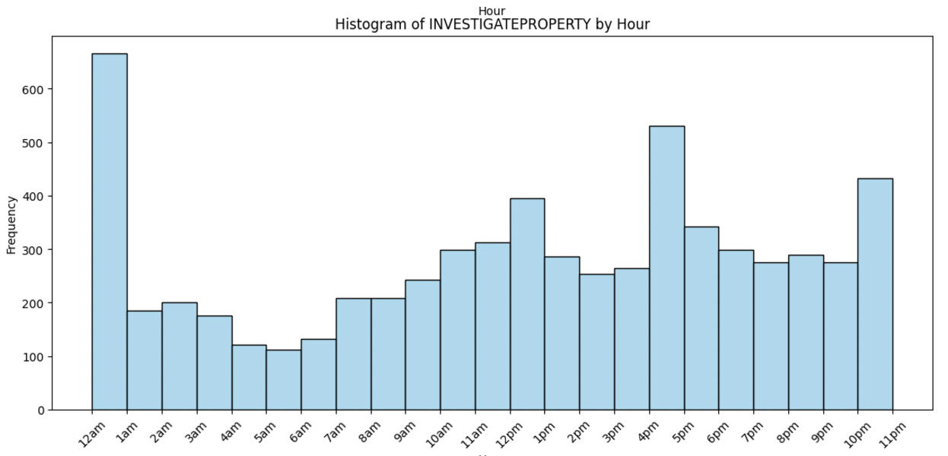
INVESTIGATE PERSON
Low: 4am-7am
High: 10pm-1am
INVESTIGATE PROPERTY
Low: 4am-7am
High: 11pm-1am

Slide 16
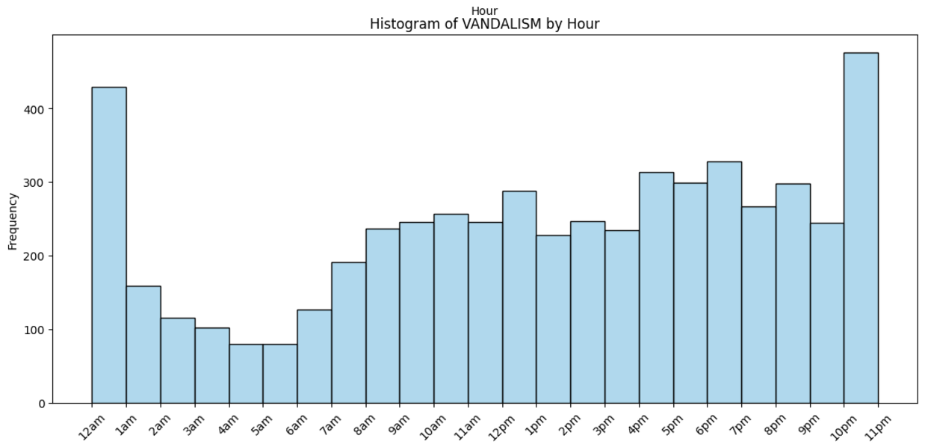
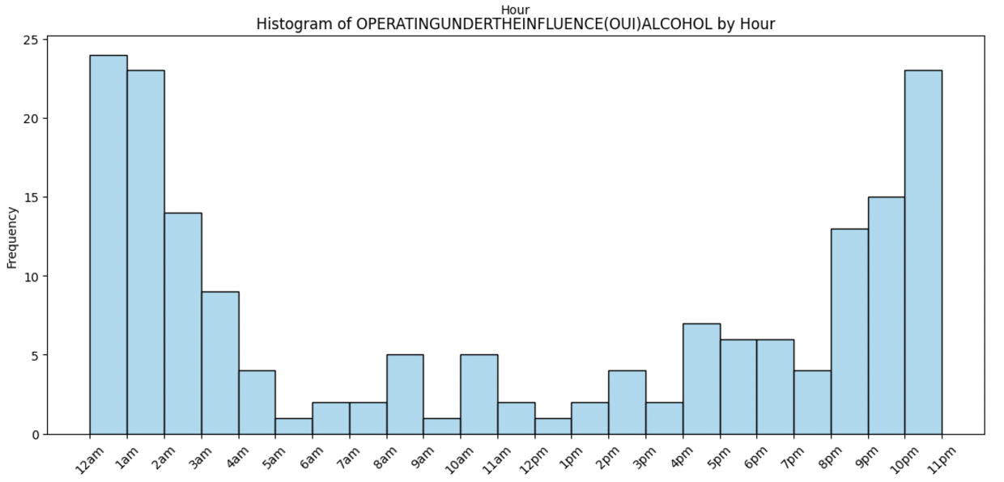
VANDALISM
Low: 4am-6am
High: 10pm-1am
OUI – ALCOHOL
Low: 5am-8am + noon
10pm-2am

Slide 17
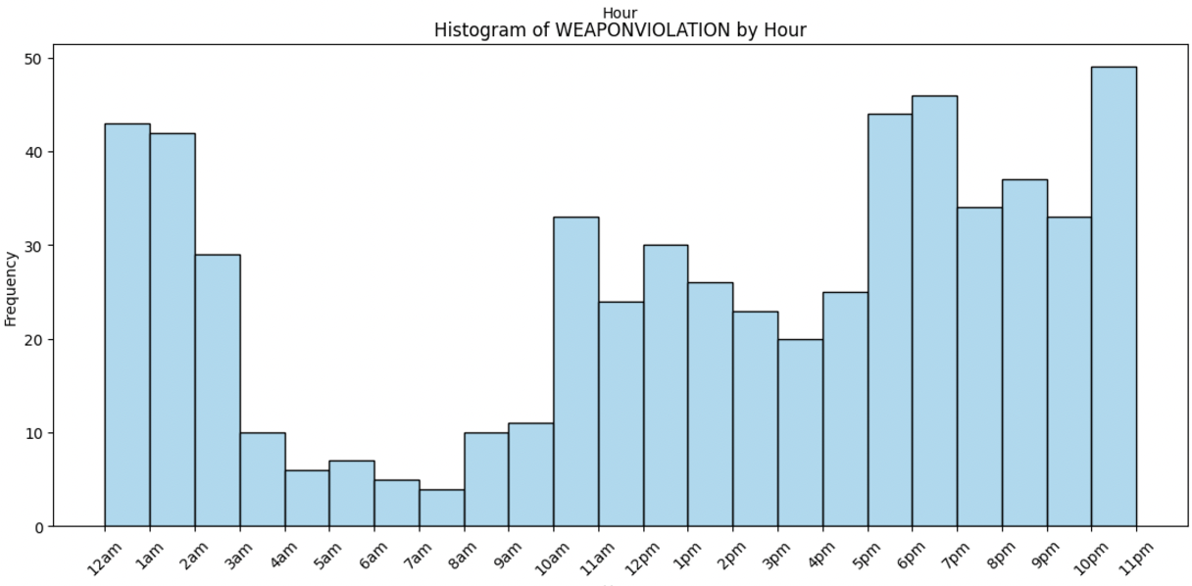
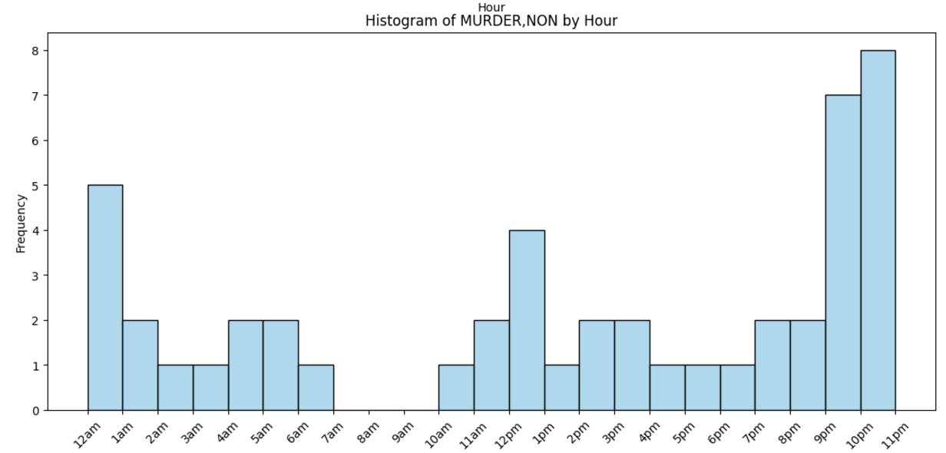
WEAPON VIOLATION
Low: 4am-8am
High: 5pm-7pm + 10pm-2am
MURDER
Low: 7am-10am
High: 9pm-12am

Slide 18
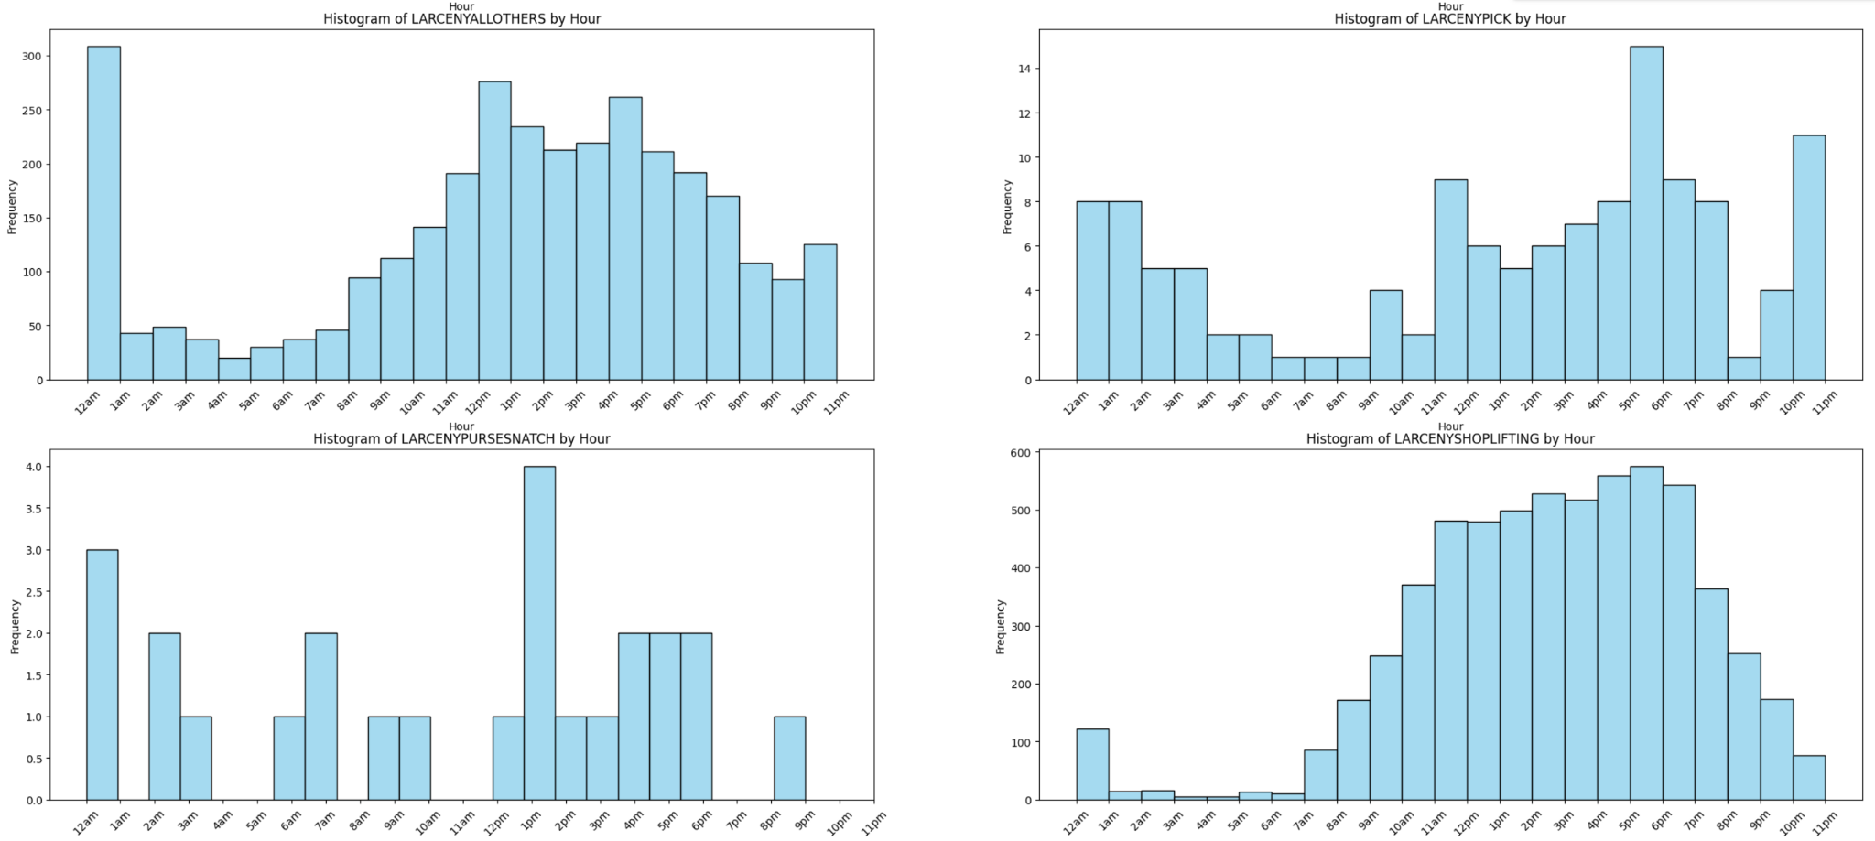
LARCENY – Low: Early Morning – High: ~5pm and Midnight

Slide 19
Prediction Model – given Month + Location + Hour: how much Crime?

Slide 20
Future Work – where might this go?

